Slide 1
LPI CASE STUDY
RAWR SUNDEVILS (Group 5)
Rob O’Dell
Andrea Perez
Will Kim
Richida Gyimah

Slide 2
INTRODUCTION
In our case study, we carried out a regression of LPI scores as a function of GDP and CPI
We introduced two outside data sets into our regression to provide samples for our explanatory variables
Our group was most interested in finding out whether CPI is statistically significant

Slide 3
COUNTRIES ANALYZED & JUSTIFICATION
Ghana
Angola
Nigeria
Cameroon
We chose Ghana to examine and wanted to examine three similar countries in size, location, and population for the analysis. So we chose to examine Ghana, Nigeria, Cameroon, and Angola.
All four have coastlines on the Atlantic Ocean, and Cameroon and Angola are close to Ghana in population. Nigeria is located close to Ghana. Three of the four countries are in West Africa, while Angola is in Southern Africa.

Slide 4
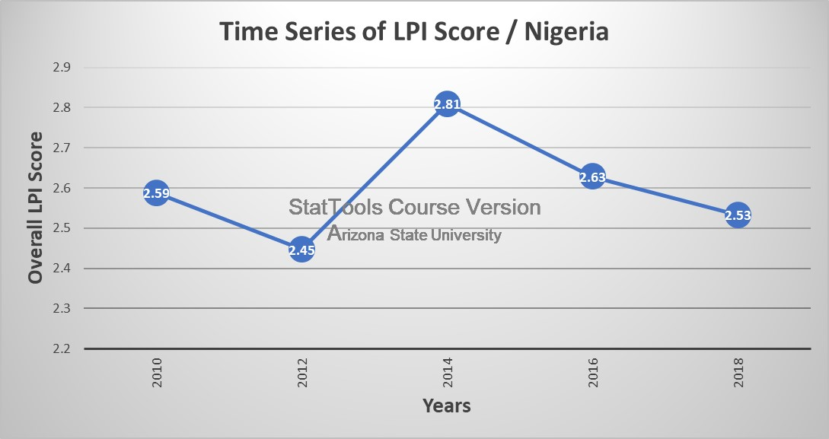
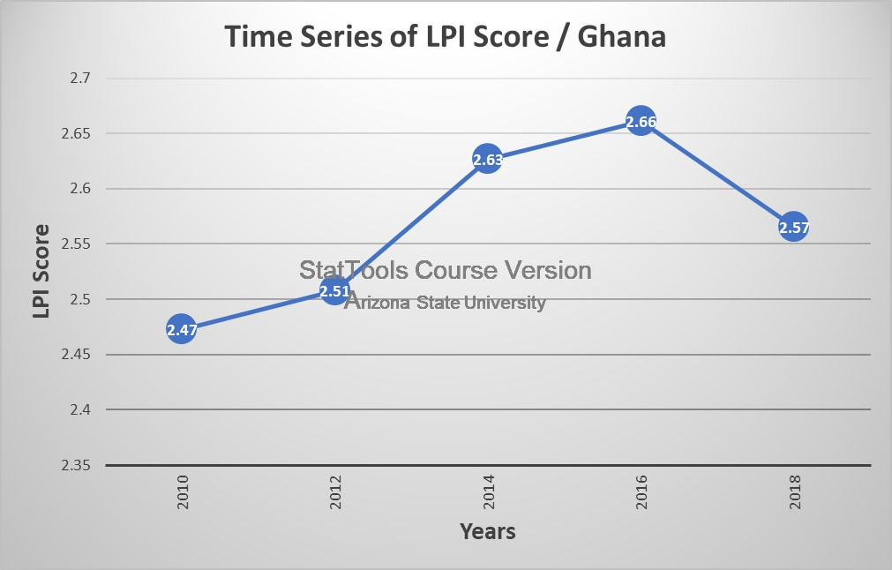
TIME SERIES GRAPHS

Slide 5
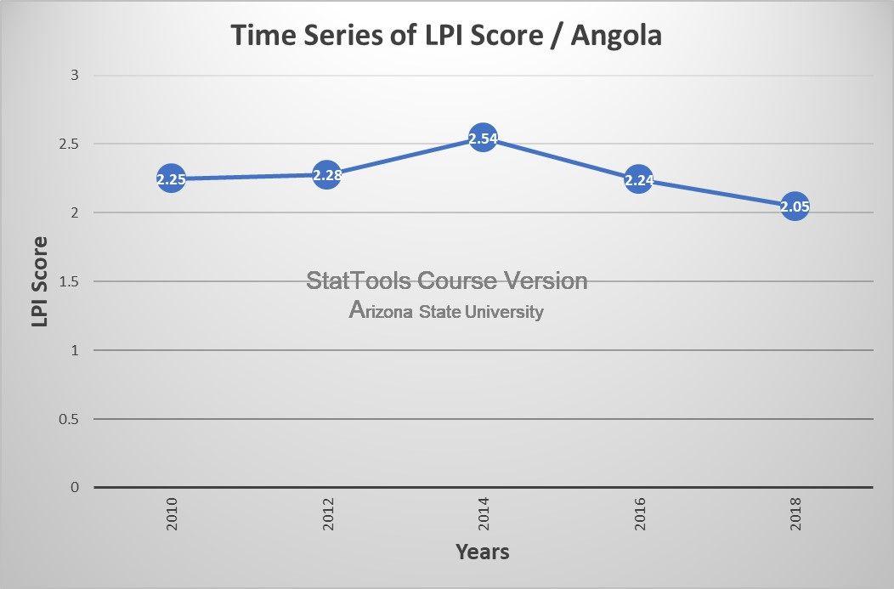
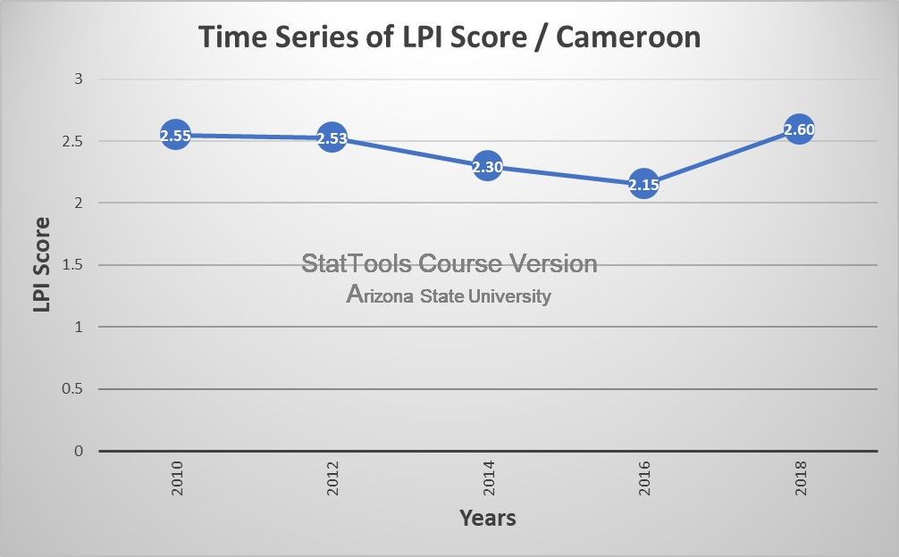
TIME SERIES GRAPHS

Slide 6
TIME SERIES INTERPRETATIONS
The average LPI score for all African countries sampled in the five years was about 2.45 each year. In each period, between 35 and 41 African countries were included in the sample. Nigeria, Cameroon, and Ghana consistently scored just about that average (in the 2.44 to 2.8 range) in each of the five years the scores were resembled, except for Cameroon which scored below average in 2014 & 2016. Angola's LPI scores were below the average of other African countries each year except in 2014.

Slide 7
REGRESSION ANALYSIS
Null hypothesis: Our null hypothesis was that a country’s level of corruption did not have a material effect on LPI scores.
Alternative hypothesis: Our alternative hypothesis was that a country’s level of corruption did have a material effect on LPI scores.

Slide 8
DATA USED
We used six data sets from the World Bank LPI site along with an annual “Corruptions Perception Index that ranks 180 countries on a zero to 100 scale based on their perceived public sector corruption.
Highly Corrupt countries score closer to zero while very clean countries rank closer to 100.

Slide 9
SIX REGRESSIONS
We ran a series of six regressions, two for data in 2018, two in 2016, and two in 2014. Each year we examined the effect of the seven variables on the entire LPI data set and contrasted it with regressions from African countries included in the LPI data that year. We ran the regressions backward, forward, and stepwise until we found the regression with the highest R squared, with an overall p-value of <.05, and having each variable in the regression with a p-value of less than <.05

Slide 10
CORRUPTION A BIG FACTOR
In 2018, for the overall dataset, we found that perceived public sector corruption had an enormous effect on the overall scores, with an R squared of .6594 in regression with LPI as the dependent variable and the public corruption score as the independent variable. With a p-value of <.0001 in Fig 1.1, the regression was statistically significant. Thus, we can say that the data provide enough evidence to reject our null hypothesis that corruption had no effect on the LPI data.

Slide 11
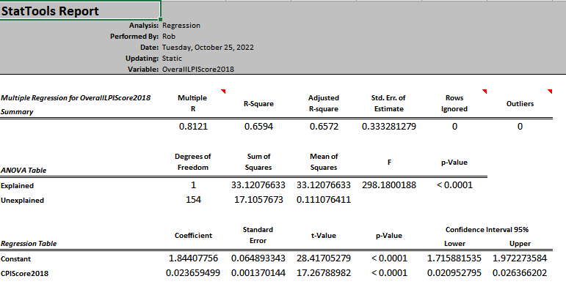
REGRESSION REPORT
All countries:

Slide 12
CORRUPTION EXPLAINS LESS IN AFRICA
For African countries in 2018, we found the R squared between LPI and the corruption score was not as pronounced. It had a .2709 R square with LPI as the dependent variable and the CPI corruption score as the independent variable. We believe the lower score is potentially because there are virtually no examples of high “very clean” scores in the data from African countries. The CPI scores for African countries averaged about 30 in 2018, 2016 and 2014, with a maximum score under 56 in each period. By contrast, Nearly 25 countries in the overall data set scored 70 or higher.

Slide 13
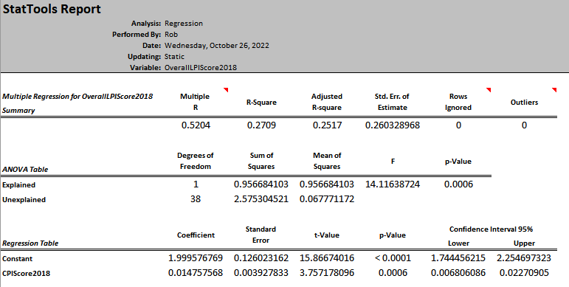
REGRESSION IN AFRICA

Slide 14
SIMILAR RESULTS IN OTHER YEARS
In 2018 the CPI alone had a lower R-Square, but with GDP, the independent variables correlated with the LPI score. In 2014 and 2016, when comparing the LPI Score with other independent variables, it shows that there is more correlation between them. Lastly, the largest R-Square was in 2016, using independent variables CPI, GDP, Exports, and Population. Combining all the independent variables showed similar results because they had high R-Square and low p-Values.

Slide 15
RECOMMENDATION
From this result, we can recommend that countries looking to improve their trade logistics should focus on improving their CPI score since their LPI score will improve consequently as well.
Additionally, our group can recommend that CPI be included in the calculations for LPI score in subsequent years due to its statistical significance.
N.B:
LPI - Logistics Performance Index
CPI - Corruption Performance Index

Slide 16
DATA SOURCE
The World Bank. (2010). Home | Logistics Performance Index. Worldbank.org. https://lpi.worldbank.org/
Transparency International e.V. (2000). Transparency International - The Global Anti-Corruption Coalition. Transparency.org. https://www.transparency.org/

Slide 17
THANK YOU

